Slide 1


Welcome to English for Programming
Week 4 Class 2
<a href="https://storyset.com/work">Illustration by Freepik Storyset</a>

Slide 2
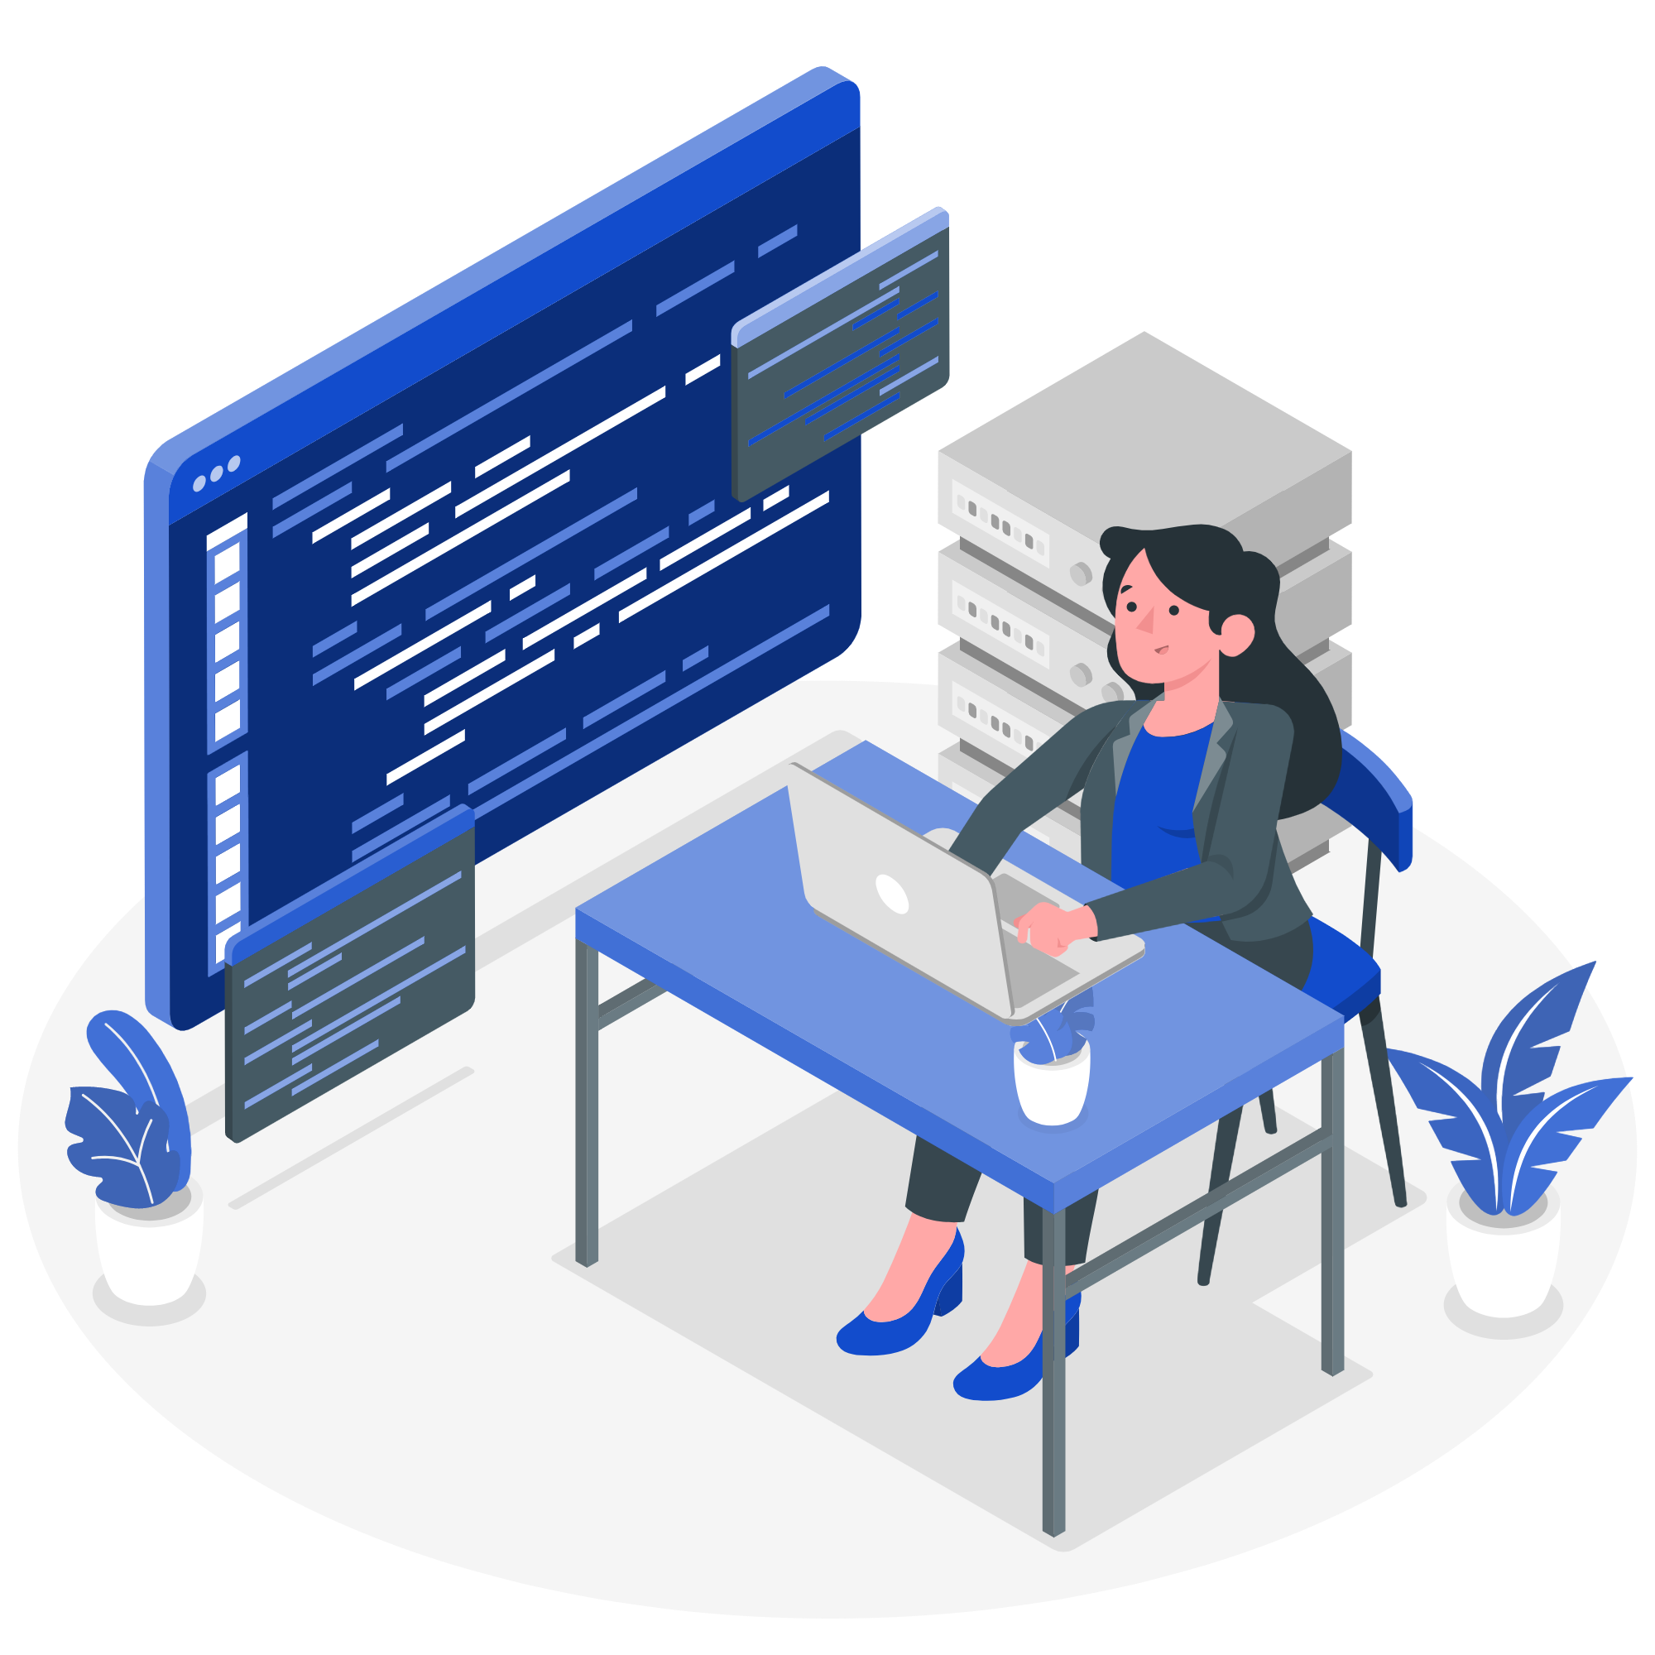
Topics for today
Review the content from your asynchronous session
Talk about jobs and problems at work
Create a survey using Present Simple Tense
Review reading strategies: skimming, scanning and vocabulary skills
Code Review made by Storyset <a href="https://storyset.com/work">Illustration by Freepik Storyset</a>

Slide 3

Checkpoint – Review
3
Name 3 things you learned
2
Mention 2 exercises you did and liked
1
Ask 1 question about something you didn’t understand
In Progress made by StorySet: <a href="https://storyset.com/work">Illustration by Freepik Storyset</a>

Slide 4


Asking questions about jobs
Consultin made by Storyset: <a href="https://storyset.com/work">Illustration by Freepik Storyset</a>

Slide 5

Warm up
Do you work 9 to 5?
Do you work overtime?
What do you like about your job?
Jobs made by StorySet: <a href="https://storyset.com/job">Illustration by Freepik Storyset</a>

Slide 6


Explore
Go to your student worksheet
Activity 1
Step 1. You are going to read a text about Jess and her husband Carl.
Step 2. As you read, complete the text with questions 1-5 from the list.
Step 3. Answer the comprehension questions.
You have 15 min to do it in groups.

Slide 7
Explore: Jobs
project manager | Web developer | CEO
administrator | System engineer | Graphic designer
How do you pronounce these jobs?
Let’s learn a new sound in English!
A _________________ in the street or in a police station.
A _________________ leads projects.
A _________________works with software.
If you want to create an infographic, you can call a ________.
A ___________ is the person in charge of leadin multinational companies.

Slide 8
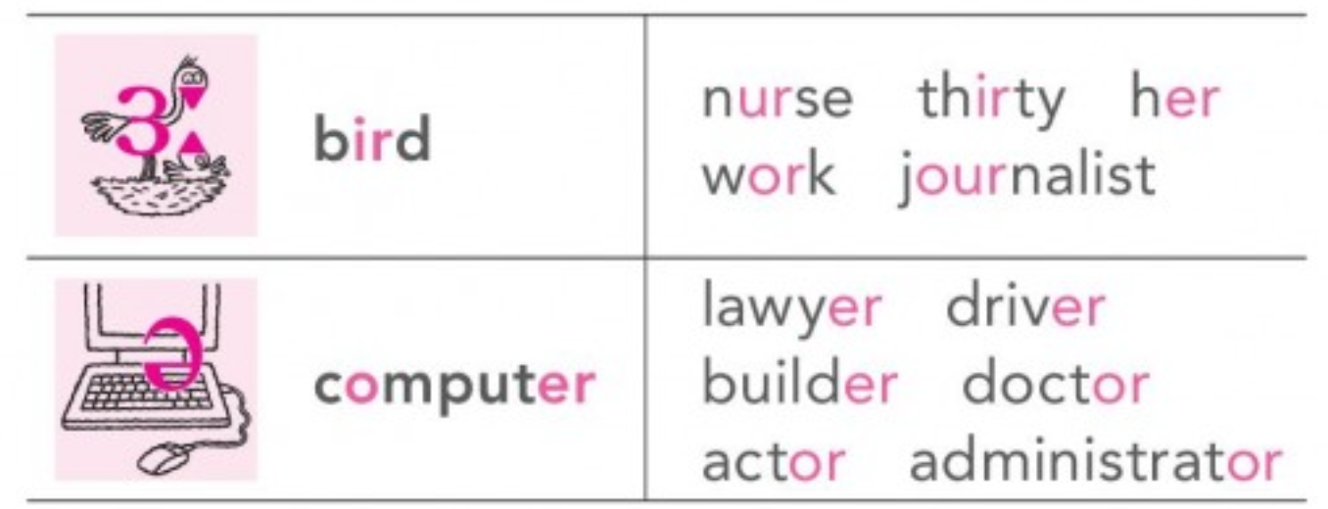
Listen to the pronunciation and try repeating the sound
Does this sound exist in your language?
Notes:
Here T plays the recording, explains, asks students to repeat out loud or for themselves. T explains that the sounds are similar but not the same

Slide 9

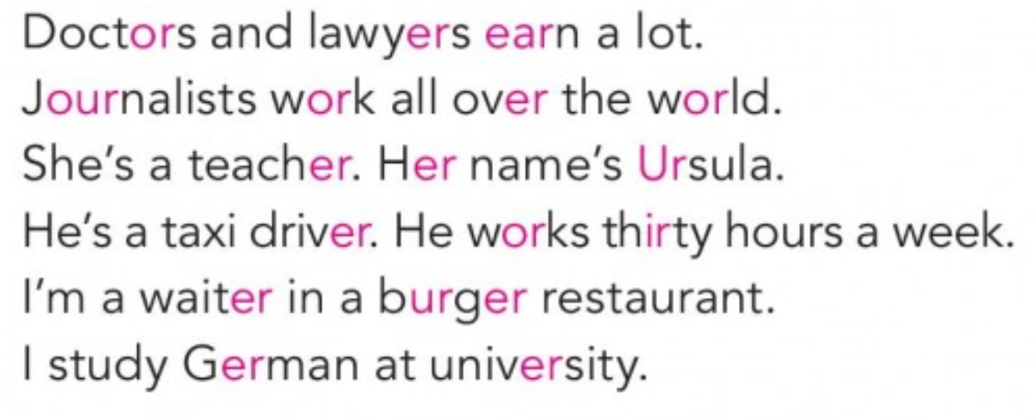
Practice
Recording 1
Listen and repeat
Do you notice A and AN?
Notes:
Play Recording 4

Slide 10
Explore
We use a before words beginning with a consonant sound (sounds like b, c, d, f, etc.):
a receptionist
We use an before words beginning with a vowel sound(how it is said, not how it is written) (sounds like a, e, I, etc.):
an accountant
We do not use a or an with plural nouns: They are architects.

Slide 11
Practice
Write the correct article (a/an) for each job.
trainee accountant executive lawyer
analyst director architect manager consultant
engineer doctor pilot cashier
technician programmer web developer

Slide 12
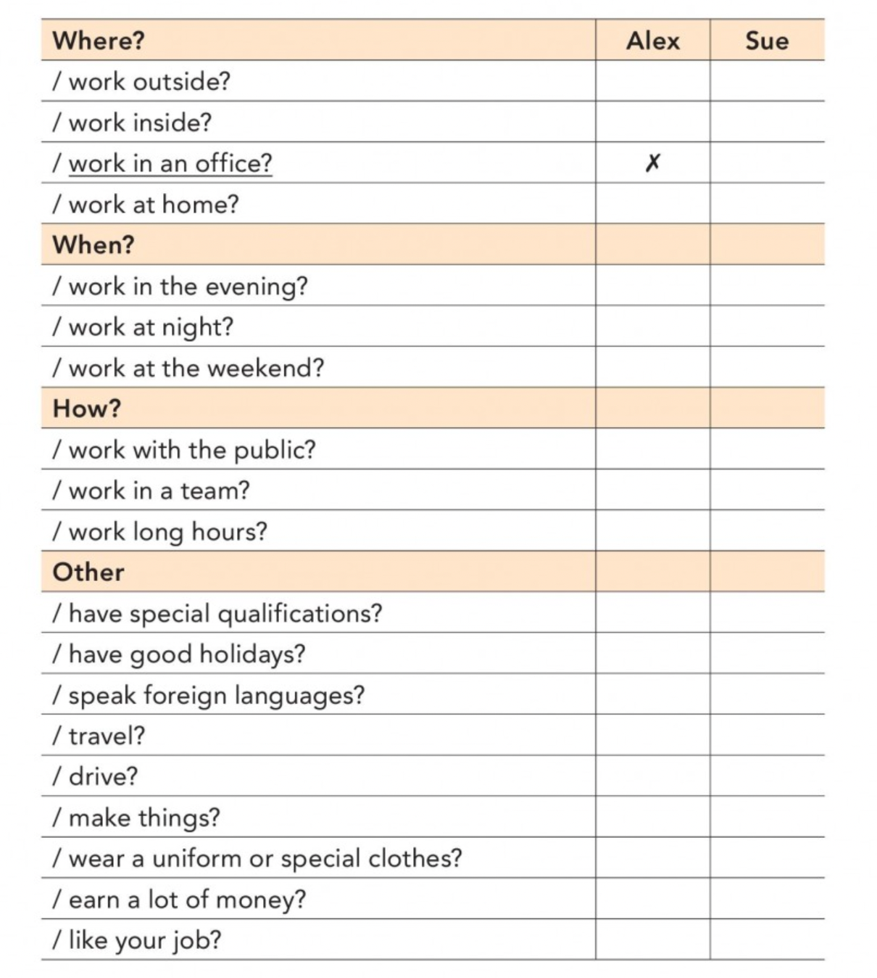
Asking Questions
Listen to Part 1 of a Game Show called His Job/Her job. Three people ask Alex and Susy about their jobs. Underline the questions they ask Alex and write them in your notebook.
Recording 2
Now listen again and pay attention to the pronunciation in questions. How do English speakers raise their intonation?
Notes:
play recording 4

Slide 13


Explore
Present Simple: Asking questions
Sentence order in questions
Recording 3
Do you work outside?
Does she wear a special uniform?
Not ALL questions have rising intonation. Yes/No questions usually have a rising intonation. At home, watch this video for more info:
https://www.youtube.com/watch?v=Aoj4HZlLQBY
Question made by StorySet <a href="https://storyset.com/people">Illustration by Freepik Storyset</a>
Notes:
play recording 2 to notice rising intonation. ask them to repeat

Slide 14
Practice: Go to your worksheets
Activity 2
What are the biggest problems for these employees? Use negative forms of the verbs.
Time 10-15 min

Slide 15

Task Time!
Group Chat made by StorySet <a href="https://storyset.com/social-media">Illustration by Freepik Storyset</a>

Slide 16

Preventing Problems
Case: Travel Application App
You are hired to improve the application called Easy Pick. The application is used by customers to find best deals on flights and hotels. Customers are not happy with the app.
Your programming team has to design a survey to ask customers about their experience and habits so you can improve it.
Create 5 questions using Present Simple Tense. As only Yes/No questions: Ex. Do you travel often?
Time: 10 min
App made by Story Set: <a href="https://storyset.com/mobile">Illustration by Freepik Storyset</a>

Slide 17

You are going to review the questions written by the other team. Use the checklist in your worksheet Time: 10 min
Peer-correction
Interview made by Storyset: <a href="https://storyset.com/work">Illustration by Freepik Storyset</a>
Notes:
T sends SS into pairs for 10 min. Then, T groups them up again, with different partners and they should interview each other.

Slide 18
Wrap up: Whole group
How did it go?
Let’s hear some questions!
Interview made by Storyset: <a href="https://storyset.com/work">Illustration by Freepik Storyset</a>
Notes:
This part is for error correction.

Slide 19

Reading Skills
Search made by StorySet: <a href="https://storyset.com/web">Illustration by Freepik Storyset</a>

Slide 20

Group work: The Importance of Python Functions
Instructions:
Step 1: You will have 20 min to work on text in your groups. Answer the questions together.
Step 2: In the main room, you will check the answers with your teacher.
Remote Team made by StorySet <a href="https://storyset.com/work">Illustration by Freepik Storyset</a>
Notes:
Here, T shares a Padlet or a Jamboard so that students can share their lists. After they get back from breakout rooom, T shares the screen and goes over teh answers. T uses this as a teaching opportunity to explain the steps when skimming.

Slide 21
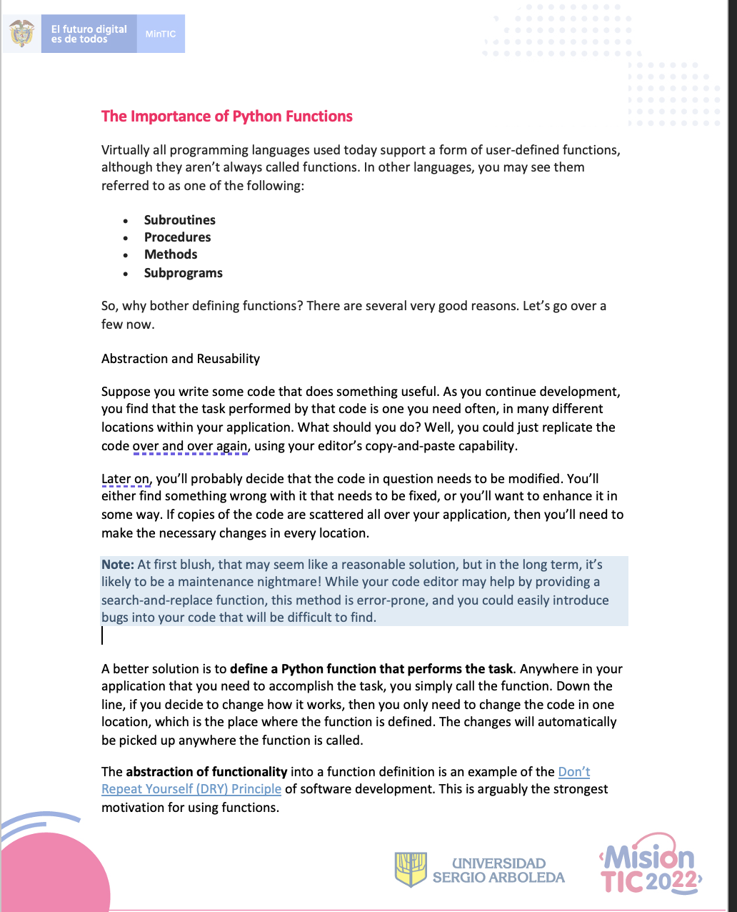
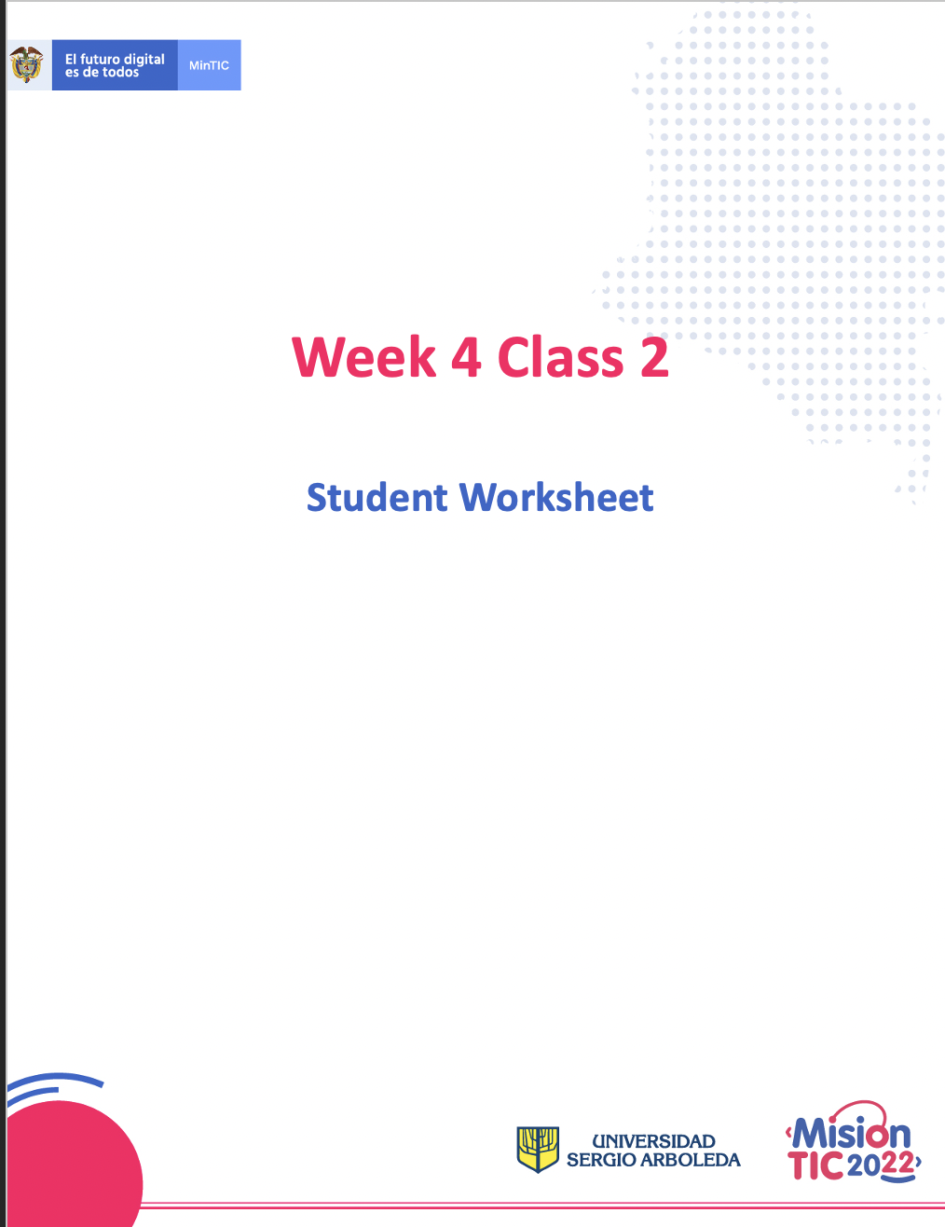
Worksheet
Download the word document from the chat.
Notes:
Teachers sends the worksheet on Zoom. Remeber to share the version WITHOUT the answer key and in WORD so that the students can edit.

Slide 22

Wrap up
Let’s check the answers!
4
Any questions?
Consulting Flat Illustration made by Storyset: https://storyset.com/illustration/consulting/rafiki

Slide 23

Autonomous
Asynchronous work
Reading Challenge 4!
10% of your course grade
Deadline to take it: By Sunday midnight

Slide 24
See you in your net class when you will learn about:
Word order in questions
Talking about family and Friends
Possessives
Reading: All Skills

Slide 25
Thank you!

